Slide 1
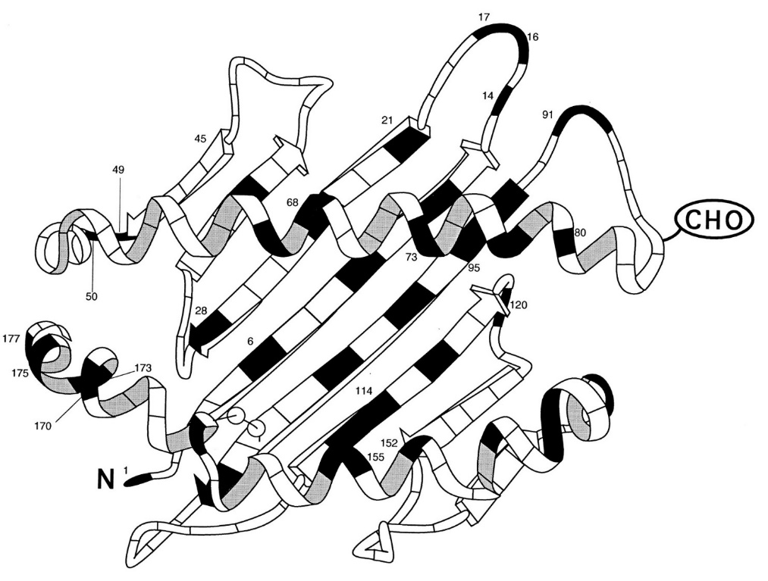
Amino acids are building blocks of HLA molecule
HLA amino acid sequence can be numbered from beginning to end
HLA molecules can be compared on the level of individual amino acids
Amino acids are fixed entities
A single surface exposed amino acid mismatch can already be sufficient to induce an antibody response
Low epitope mismatch level do not guarantee low immunogenicity

Slide 2
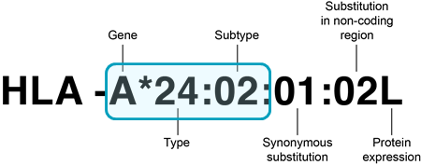

HLA alleles included in HLA-EMMA v1.06
HLA amino acid sequences
All HLA alleles were extracted from the IPD-IMGT/HLA database v3.47 (n= 20.598)
HLA alleles are included up to second field typing resolution
HLA class I amino acid sequence positions: 1 to 275
HLA class II amino acid sequence positions: 1 to 226
HLA typing input preferentially second field
Non-expressed alleles indicated with N
Option to convert serological typing to most likely second field (population based)
Kramer et al., HLA 2020

Slide 3
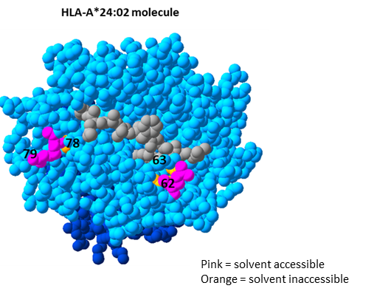
Definition of solvent accessible polymorphic amino acid positions
HLA crystal structures were obtained from RSCB protein data bank
Open source tools (NetSurfP2.0 and Porter Pale4.0) were used to predict the relative solvent accessibility of each position
Solvent accessible polymorphic positions
Position was defined as solvent inaccessible if both tools predicted a relative solvent accessibility of lower than 25% for this position on all HLA structures of HLA locus
Polymorphic positions within locus based on all HLA alleles of that locus
Kramer et al., HLA 2020

Slide 4
Functionality of HLA-EMMA
A tool to perform compatibility analysis on amino acid level between donor and recipient with focus on solvent accessible amino acid mismatches
Analysis of HLA class I and class II simultaneously
Available for all populations by including all known HLA alleles
Applicable for analyses of large cohorts by incorporating batch analysis option
Providing both the number as well as the position and type of amino acid mismatches
A user-friendly software program
Kramer et al., HLA 2020

Slide 5
Future functions of HLA-EMMA
Defining eplet mismatches between recipient and donor
Defining of eplets on unacceptable HLA molecules
Determining stem cell accessible amino acid mismatches between host vs graft and graft vs host
Kramer et al., HLA 2020

